Slide 1
AI AGENTS & RAG · MODULE 6 · LESSON 1 OF 4
Building RAG with n8n
Lesson 1 — Connect, Authenticate & Find a Real File
Today: from zero access to a real file ID
Beginner · 120 minutes · No coding required
Notes:
Welcome. Two goals today. First, understand what RAG is and the five words that appear in every RAG system. Second, connect n8n to Google Drive and prove it works by finding a real file. Everything we build in the next three lessons stands on this connection, so it is worth getting right. Ask students to open n8n and drive.google.com now so they are ready.

Slide 2
ROADMAP
What we do today
1
2
3
4
The idea
The vocabulary
The lab
The proof
Why an AI model cannot answer from your files, and how RAG fixes it.
Document, chunk, embedding, vector store, semantic search.
Google Cloud, the Drive API, OAuth, and the n8n workflow.
n8n returns a real file name and a real Google Drive file ID.
WHERE WE STOP
Lesson 1 ends the moment n8n can see a file in your Drive. Chunking, embeddings, the vector store and the AI agent are Lessons 2 to 4 — but you will understand all of them by the end of today.
Lesson 1 — Connect, Authenticate & Find a Real File
Notes:
Set expectations clearly. Half the session is concepts, half is clicking. Warn them that the Google Cloud part is fiddly the first time and that two specific errors are almost guaranteed — we will meet both and fix both.

Slide 3
PART 1
Why RAG exists
Before we click anything, we need to know what problem we are solving — and why the obvious fix is the wrong one.
Notes:
Transition slide. Ask the room: has anyone asked ChatGPT about something inside their own university files and got a confident wrong answer? That is exactly the problem RAG solves.

Slide 4
THE PROBLEM
Ask a language model this question
“How many students are registered in the AI program, and when is the final project due?”
It cannot answer
Two blind spots
Not because the model is weak. The answer lives in University_AI_Course.txt in your Google Drive, and nobody ever showed that file to the model.
1. It does not know your private files — your Drive was never in its training data.
2. It does not know what changed after training.
REMEMBER
A brilliant graduate who read everything public up to a date, then locked in a room with no internet and no access to your files. Ask general knowledge — excellent. Ask your attendance policy — they guess.
Lesson 1 — Connect, Authenticate & Find a Real File
Notes:
Read the question out loud. Ask students whether they think a model could answer it. The point is not that models are unreliable, but that they were never given the document. Being helpful, a model may guess — that guess is what we are eliminating.

Slide 5
DEFINITION
RAG = Retrieval-Augmented Generation
1
2
3
Retrieval
Augmented
Generation
Search a knowledge source and pull out the passages related to the question.
Add those passages to the prompt, so the model sees them next to the question.
The model writes the answer using the passages it was given.
IN OUR PROJECT
Retrieval search a vector store built from your Google Drive documents
Augmented n8n assembles the question and the retrieved chunks into one prompt
Generation Gemini writes the final answer from what it was given
Lesson 1 — Connect, Authenticate & Find a Real File
Notes:
Have the class say the three words back to you in order. Order matters — retrieval happens before generation, which is why the quality of retrieval sets the ceiling on answer quality.

Slide 6
MENTAL MODEL
What happens when someone asks a question
Question
Retrieve
Context
LLM
Answer
A student types something in plain language.
The system searches the store for related chunks.
The best chunks are pasted into the prompt.
The model reads question + chunks together.
A grounded answer, traceable to a source.
KEY IDEA
The model is never modified. The only thing that changes between a bad answer and a good one is what we put in the Context box — and that is entirely under our control.
Lesson 1 — Connect, Authenticate & Find a Real File
Notes:
Walk left to right, then walk it backwards: if the answer is wrong, which box do you inspect first? Context. Then retrieve. Almost never the model itself.

Slide 7
PART 2
The five words
Document · chunk · embedding · vector store · semantic search. Every node you will see in n8n is one of these.
Notes:
Tell students this is the vocabulary section and that these five words appear in every RAG job description they will ever read.

Slide 8
WORDS 1 AND 2
Document and chunk
Document
Chunk
The original file, exactly as it exists. Ours: University_AI_Course.txt
A small slice of that document — roughly a paragraph — retrievable on its own.
Why not just use the whole document?
Context is limited. A model reads only so much text at once. A fifty-page handbook will not fit.
1
Precision. Retrieve a whole handbook and the one useful sentence drowns in noise — the answer gets worse.
2
Our workflow: 1,000 characters per chunk, 200 characters of overlap.
Lesson 1 — Connect, Authenticate & Find a Real File
Notes:
Chunk size is a real engineering decision, not a default to ignore. Too small and a chunk loses its meaning; too large and retrieval loses precision. 1000/200 is a sensible starting point for prose.

Slide 9
WHY CHUNKS OVERLAP
A cut can land in the middle of an idea
Students must achieve at least 70% to successfully complete the program.
Split with no overlap
…must achieve at least
70% to complete the program
✕
Neither chunk answers the question
Split with 200 characters of overlap
…must achieve at least 70% to
✓
The full sentence survives in chunk 2
achieve at least 70% to complete the program.
Overlap is cheap insurance: the boundary sentence appears at the end of one chunk and the start of the next.
Lesson 1 — Connect, Authenticate & Find a Real File
Notes:
Point at the shaded blocks. Without overlap the sentence is torn in two and neither half is retrievable as an answer. With overlap, chunk 2 contains the whole statement. This is the single most common cause of 'the answer is in the document but the system cannot find it'.

Slide 10
WORD 3
Embedding — meaning turned into numbers
An embedding is a list of numbers that represents the meaning of a piece of text.
Text with similar meaning produces numbers that sit close together.
Think of it as a map of meaning
“I need to pass the course”
“The minimum grade to complete the program”
“The weather in Istanbul”
lands here
lands right next to it
lands on the other side of the map
RULE FOR THE REST OF THE COURSE
The question and the documents must be embedded by the same model. Two models draw two different maps, and coordinates from one map mean nothing on the other.
Lesson 1 — Connect, Authenticate & Find a Real File
Notes:
Nobody needs the mathematics today. What they need is the intuition that an embedding is a position on a map of meaning, and that similarity is measured as distance on that map. The warning at the bottom prevents a real bug in Lesson 2.

Slide 11
WHY EMBEDDINGS BEAT KEYWORDS
A student asks: “What score do I need to pass?”
The document says: “Students must achieve at least 70% to successfully complete the program.”
✕ Keyword search finds nothing
✓ Semantic search finds it
The words “score” and “pass” do not appear anywhere in that sentence. There is no character overlap to match on.
“What score do I need to pass” and “must achieve at least 70% to successfully complete” mean nearly the same thing — and meaning is what an embedding measures.
Keyword search matches identical characters · no synonyms · no paraphrase · no other language
Semantic search matches similar meaning · handles synonyms, paraphrase and often other languages
Lesson 1 — Connect, Authenticate & Find a Real File
Notes:
This is the slide that makes embeddings click. Ask students to find a keyword shared between the question and the sentence — there isn't one. Then ask whether a human would say they mean the same thing. That gap between characters and meaning is exactly what embeddings close.

Slide 12
WORDS 4 AND 5
Vector store and semantic search
Vector store
Semantic search
A database that keeps embeddings together with the text they came from, and can search them by similarity.
Ours: the Simple Vector Store node, key user_documents.
Embed the question, then find the stored chunks whose vectors sit closest to it.
The result is the “right page” we hand to the model.
The whole pipeline, both phases
PHASE A — INDEXING · once per document
Load
Extract
Split
Embed
Store
PHASE B — ANSWERING · every question
Embed question
Search store
Build prompt
Generate
Lesson 1 — Connect, Authenticate & Find a Real File
Notes:
Stress that the two phases run at different times. Indexing happens once, in advance. Answering happens on every question. Students who confuse the two end up re-indexing a document on every request, which is slow and expensive.

Slide 13
PART 3
Today’s build
Google Cloud, the Drive API, OAuth, and the first two nodes of the n8n workflow.
Notes:
Switch mode here: from concepts to clicking. Tell students to follow along and to say something the moment they get stuck rather than falling silently behind.

Slide 14
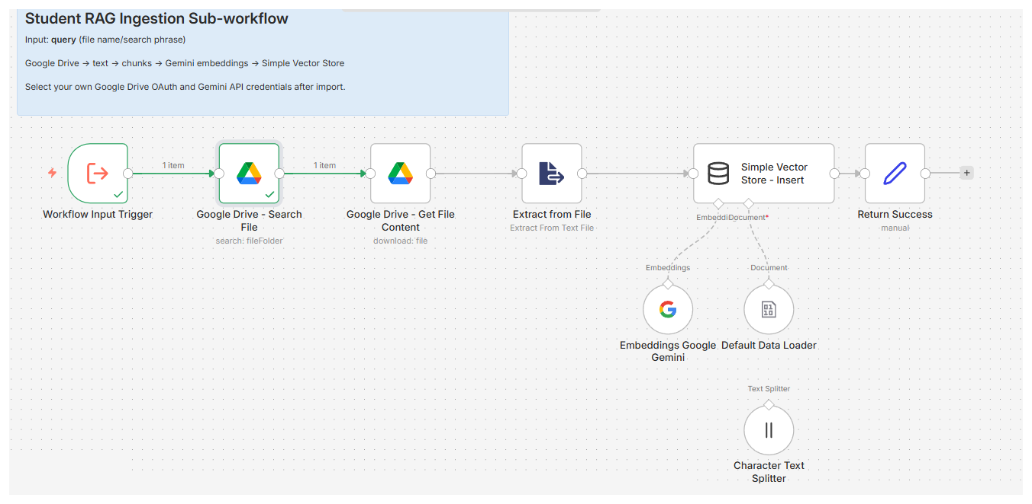
THE WORKFLOW
Where n8n fits
n8n is a workflow tool: each node does one job, then hands its output to the next. No code required.
Lesson 1 · the first two nodes
Lessons 2–4 · extract, split, embed, store, retrieve
Lesson 1 — Connect, Authenticate & Find a Real File
Notes:
Show the canvas and name the nodes left to right. Point out the round nodes hanging below the vector store — embeddings, data loader and text splitter are sub-nodes, which is why their connectors are dotted. Students often think a dotted line means broken.

Slide 15
TWO SETUP WORDS
API and OAuth
API
OAuth
An agreed way for two programs to talk. Google Drive publishes one: “search for a file named X”, “download the file whose ID is Y”.
Enabling the Drive API opens that door for your project.
A way to grant an application permission to act for you — without giving it your password.
n8n receives a token that you can revoke at any time.
THE HOTEL KEY CARD
You are never handed the master key, and you never give the front desk your house keys. You get a card that opens one room, works for a limited time, and can be cancelled. OAuth is that card.
SECURITY RULE
A Client Secret is a password. Never show one in class, in an assignment, in a screenshot or on GitHub. If one leaks, delete that OAuth client and create a new one — it takes two minutes.
Lesson 1 — Connect, Authenticate & Find a Real File
17
Notes:
The hotel key card analogy is the one students remember. Make the revocation point explicit: they can go to their Google account security page right now and see n8n listed, and remove it with one click. That is the whole value of OAuth.

Slide 16
TODAY’S GOAL
What “finished” looks like
1
Enable the Google Drive API inside one Google Cloud project
2
Complete OAuth sign-in with your own account as a test user
3
Import the workflow and point the node at your credential
4
Search for University_AI_Course.txt and read back its name and file ID
SUCCESS LOOKS LIKE THIS
[ { "id": "1Q1RuGYHSrAGb1Q4i44MuI3naqI9dfkKn", "name": "University_AI_Course.txt" } ]
Your ID will be different — every file in Drive has its own. What matters is that a real name and a real ID come back.
Lesson 1 — Connect, Authenticate & Find a Real File
Notes:
Put this slide back up whenever someone asks whether they are finished. If the output panel shows a name and an id, they are done. If not, they are not — and Part 5 of the manual tells them which of nine things went wrong.

Slide 17
THE LAB
Nine steps, about 40 minutes
1
2
3
Upload the file
Create the project
Enable the Drive API
Google Drive
Google Cloud
Google Cloud
4
5
6
Configure the consent screen
Create the OAuth client
Connect the credential
Google Cloud
n8n → Google Cloud
n8n
7
8
9
Import the workflow
Understand the input
Search for the file
n8n
n8n
n8n
Each step in the manual ends with a check. Do not move on until it passes — every step depends on the one before it.
Lesson 1 — Connect, Authenticate & Find a Real File
Notes:
Set a pace: steps 1 to 3 in fifteen minutes, then regroup. The consent screen and OAuth client are where the class will spread out most, so plan to circulate during steps 4 and 5.

Slide 18
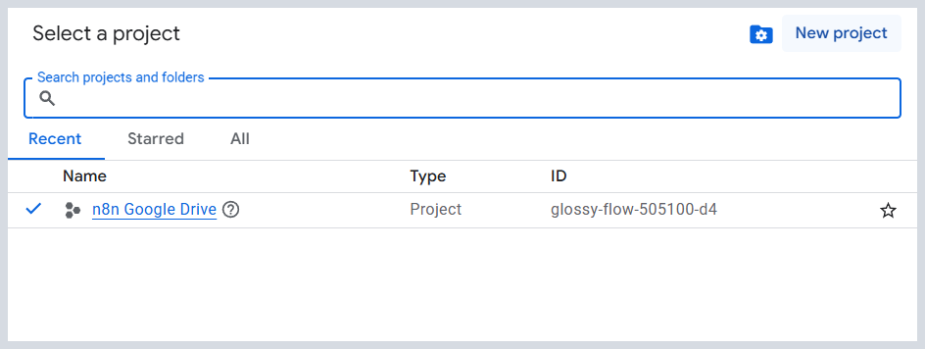
STEPS 1 AND 2
Upload the file, then pick one project
1
Upload to Drive keep the file name exactly as given
2
Note the account every later step uses this same one
3
Open Google Cloud console.cloud.google.com
4
Create or select a project for example “n8n Google Drive”
The tick shows the active project — this name must stay in the top bar.
WRITE IT DOWN — YOU WILL NEED BOTH
Project name: ________________________________ Project ID: ________________________________
Google’s error messages name your project by ID, never by the friendly name.
Lesson 1 — Connect, Authenticate & Find a Real File
Notes:
Insist on the exact file name; the search in step 9 will not forgive a typo. The project ID matters because Google’s error messages quote the ID, never the friendly name, and students cannot match them up otherwise.

Slide 19
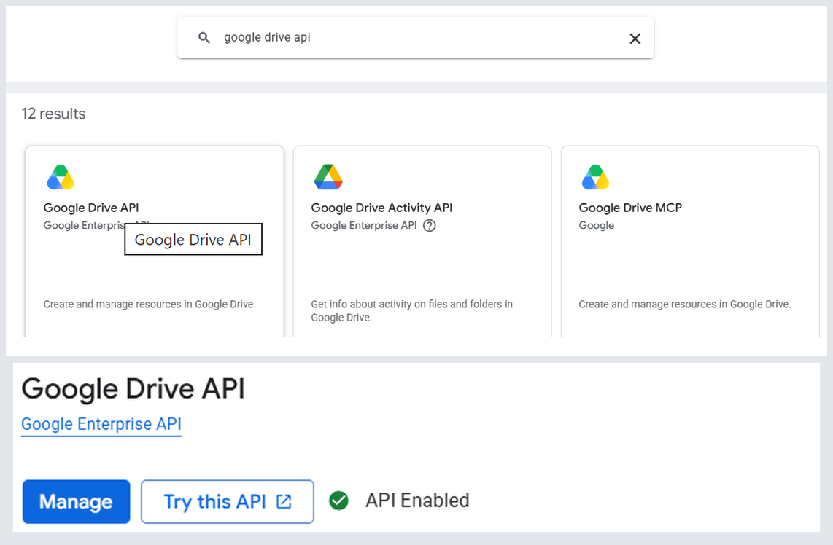
STEP 3
Enable the Google Drive API
1
Check the top bar your project must be the selected one
2
APIs & Services → Library from the navigation menu
3
Search “Google Drive API” not Activity, not Labels
4
Click Enable and wait for the page to reload
Pick the first card — then check for the green API Enabled badge.
THE MOST COMMON FAILURE IN THE LAB
Enable the API while the wrong project is selected and n8n will later say the Drive API “has not been used in project … or it is disabled”. Nothing you change in n8n will help — check the top bar before you click Enable.
Lesson 1 — Connect, Authenticate & Find a Real File
Notes:
Pause here and have everyone read their own top bar aloud, or at least check it. Thirty seconds now saves a ten-minute debugging detour later — this single mistake accounts for most of the errors in this lab. The lower screenshot is what students should compare against: a green API Enabled badge and a Manage button, not an Enable button.

Slide 20
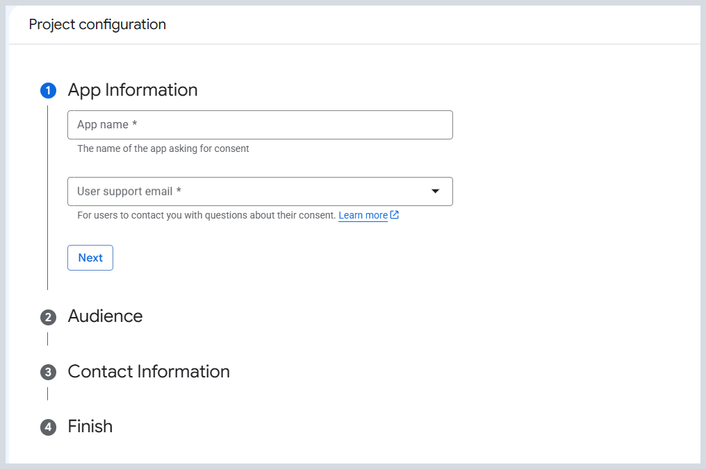
STEP 4A AND 4B
Configure the consent screen
In the current console this lives under Google Auth Platform, not the old OAuth consent screen page.
1
Google Auth Platform then Get started on a fresh project
2
App Information app name + your support email
3
Audience: External the only option for a personal account
4
Contact Information your own email again
5
Finish → Create agree to the policy and create
The four-step form. Each section opens as you finish the one above.
NO PUBLISHING, NO VERIFICATION
You do not need to publish the app and you do not need Google verification — that process is for applications used by the public. A classroom project stays in Testing mode indefinitely, with a cap of 100 test users.
Lesson 1 — Connect, Authenticate & Find a Real File
Notes:
Google renamed and moved this page, so older tutorials point at a URL that no longer exists. If a student cannot find it, tell them to type “Google Auth Platform” into the console search bar. The four steps take about three minutes.

Slide 21
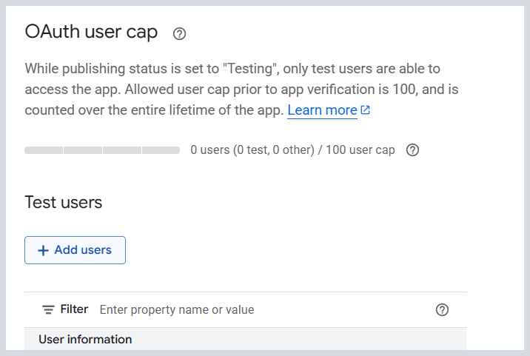
STEP 4C
Add yourself as a test user
Separate page, easy to miss — and skipping it is the number one cause of the 403 error.
1
Google Auth Platform → Audience in the left menu
2
Find Test users under the OAuth user cap section
3
+ Add users type the exact Google account, then save
4
Check the table your address must actually appear in it
Google states the rule on the page itself.
READ THE PAGE OUT LOUD
“While publishing status is set to Testing, only test users are able to access the app.” That is the whole rule. The account you sign into n8n with must be on that list, or Google refuses it with a 403 that never mentions test users.
Lesson 1 — Connect, Authenticate & Find a Real File
Notes:
This is the slide to linger on. The 403 error message students will hit says nothing about test users, so they go hunting through the wrong settings for twenty minutes. Have every student confirm their own address is in the table before you move on.

Slide 22
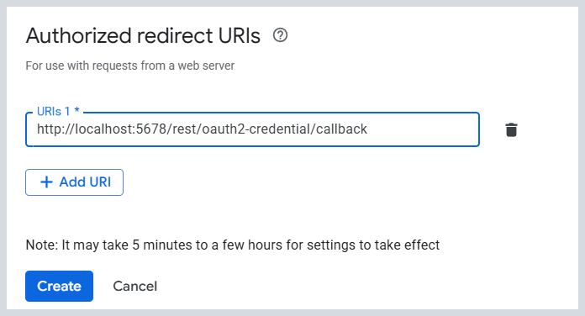
STEP 5
Create the OAuth client
Unusual order: get the redirect URL out of n8n first, because Google’s form asks for it.
1
In n8n copy the OAuth Redirect URL
2
Clients → Create OAuth client in Google Auth Platform
3
Application type Web application
4
JavaScript origins leave completely empty
5
Authorised redirect URIs + Add URI, then paste it in
Paste it exactly — and note Google’s timing warning.
REDIRECT_URI_MISMATCH
SECURITY RULE
Google compares character by character:
http:// vs https:// · /callback vs /callback/ · 5678 vs 5679
The Client Secret is a password. Copy it into n8n and nowhere else — never into a slide, a chat or a screenshot.
Lesson 1 — Connect, Authenticate & Find a Real File
Notes:
Two things to stress. First the order: students who work left-to-right through Google's form get stuck because they do not yet have the redirect URL. Second, Google's page says settings can take five minutes to a few hours to apply — so a mismatch error immediately after creating the client is sometimes just impatience.

Slide 23
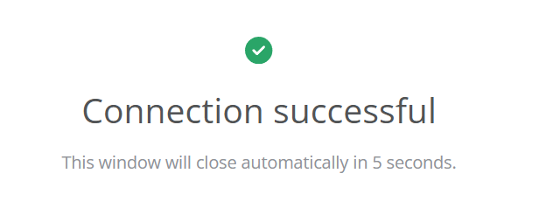
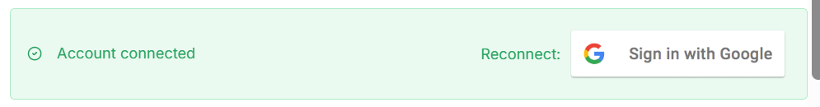
STEP 6
Connect the credential in n8n
1
Paste Client ID and Client Secret into the n8n credential
2
Click Sign in with Google a Google window opens
3
Choose the right account the one you added as a test user
1 · the Google pop-up closes itself
4
Approve Drive access then name and save the credential
2 · and n8n shows Account connected
IF IT FAILS, STOP HERE
Access blocked / 403 → you are not on the Test users list, or signed in with another account
redirect_uri_mismatch → re-copy the URL from n8n into the OAuth client
invalid_client → a stray space in the ID or secret; re-copy both
Nothing happens at all → your browser blocked the pop-up
Lesson 1 — Connect, Authenticate & Find a Real File
Notes:
Do not let anyone continue past this slide with a broken credential — every remaining step depends on it. Walk the room and check for the green tick before moving on.

Slide 24
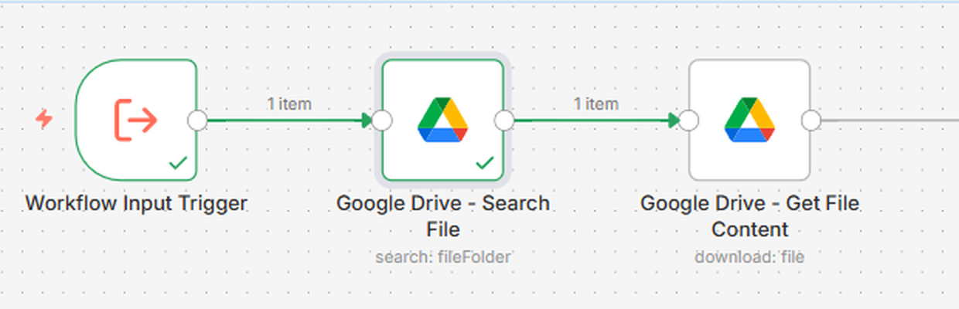
STEPS 7 AND 8
Import the workflow, then read the input
After import these are the only two nodes Lesson 1 uses.
The input field is called query. The file name is the value you pass into it.
✓ Correct
✕ Incorrect
Field name: query
Value passed in: University_AI_Course.txt
The workflow can search for any file.
Field name: University_AI_Course.txt
The node reads {{ $json.query }} — rename the field and that expression points at nothing.
Lesson 1 — Connect, Authenticate & Find a Real File
Notes:
The envelope analogy: the field name is the label printed on the envelope; the file name is the letter inside. You do not reprint the envelope to send a different letter. Also remind them an imported workflow never carries the author's credentials — that is a safety feature.

Slide 25
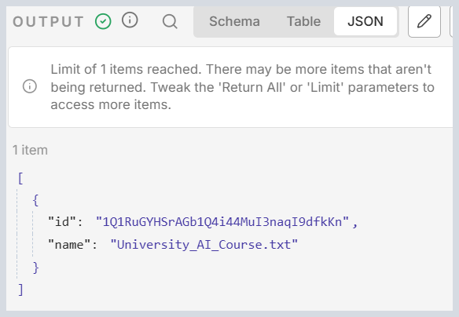
STEP 9
Search for the file and read the result
Resource File/Folder
Operation Search
Search Method Search File/Folder Name
Search Query University_AI_Course.txt
Return All Off
Limit 1
The output panel — a real name and a real file ID.
name
id
Confirms you found the file you meant, not a similarly named one.
The file’s permanent address in Drive — Lesson 2 downloads by ID, never by name.
Lesson 1 — Connect, Authenticate & Find a Real File
Notes:
Click Execute step, not Execute workflow — running one node at a time is the habit you want them to build. Explain why the ID matters: it survives renaming and moving, which the name does not.

Slide 26
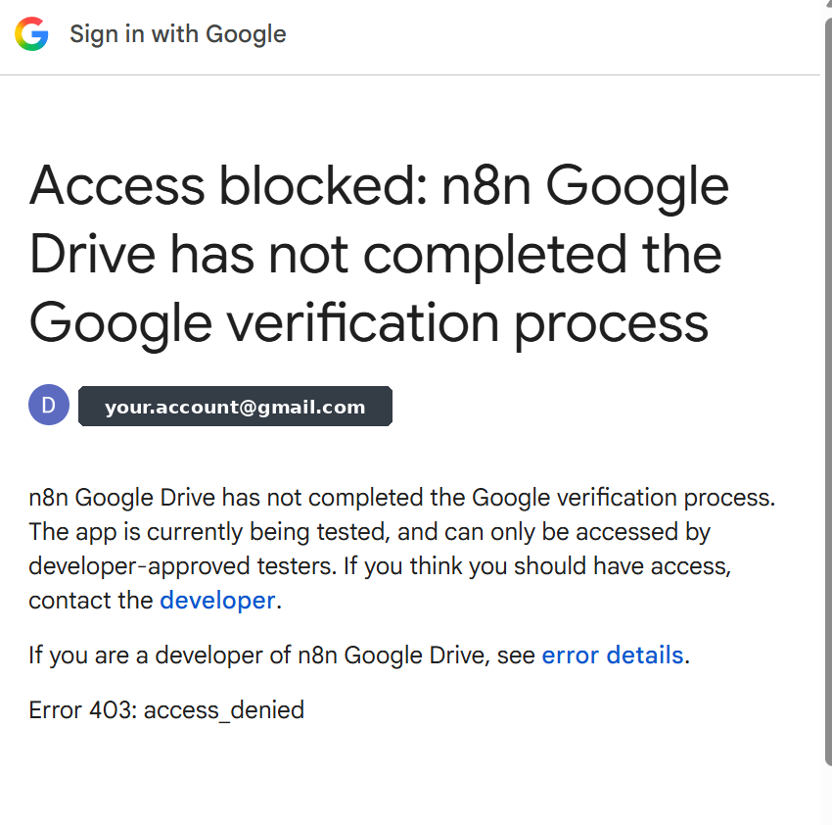
TROUBLESHOOTING
The two errors you will almost certainly meet
“Access blocked: … has not completed the Google verification process”
“Google Drive API has not been used in project 3175… or it is disabled”
Cause: your app is in Testing and the account you signed in with is not a test user.
Fix: Google Auth Platform → Audience → Test users → add that exact address, then sign in again.
Cause: the API is enabled in a different project from your OAuth client.
Fix: open the project named in the message, enable the Drive API, wait 2–5 minutes, retry.
THE ONE QUESTION THAT SOLVES MOST PROBLEMS
Are the enabled Drive API, the OAuth client and the n8n credential all in the same Google Cloud project — authorised with the same Google account?
Lesson 1 — Connect, Authenticate & Find a Real File
Notes:
Show the real 403 screen on the left and point out what it does NOT say: nothing about test users, nothing about the Audience page. That gap is why students go hunting in the wrong place. Then teach the habit of reading the project number out of the second error and comparing it to the project in the top bar — that single skill resolves four of the nine problems in the manual.

Slide 27
CHECKPOINT
Before you leave the session
Google Drive API enabled in my project
n8n credential connected and green
OAuth consent screen configured
Workflow imported — eight nodes on the canvas
My account listed as a test user
Search File returns a name and an id
OAuth client created with n8n’s redirect URL
I can explain field name versus value
THEN TEACH IT TO SOMEONE ELSE
Turn to the person next to you and explain in under a minute what happened when you clicked “Sign in with Google” — what n8n asked for, what Google checked, and what n8n received. If you can do that fluently, you understand OAuth better than most people who use it daily.
Lesson 1 — Connect, Authenticate & Find a Real File
Notes:
Give them two minutes for the pair explanation. It surfaces misunderstandings faster than any question you could ask from the front, and it is the moment the OAuth flow usually clicks.

